Slide 1
State of CA IT Apprenticeship Program for New & Incumbent Workers
A Partnership between State of CA Dept. of Technology, CA Community Colleges & Mission College: Silicon Valley Technical Apprenticeship Program Grant, Cisco,
July 27, 2017

Slide 2
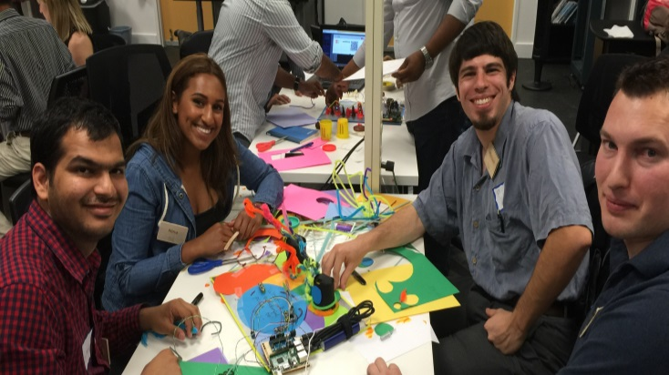
Global Community
Hands-On
Flexible Delivery
A Learning Experience at the Networking Academy
Building the Workforce to Power the Digital Economy
Personalized
65 of the 113 community colleges in CA deliver Networking Academy courses
Hackathons
Simulations
2
© 2016 Cisco and/or its affiliates. All rights reserved. Cisco Confidential
Notes:
Packet Tracer-based competitive games. Hack-a-thons. National and global IT competitions -- including the Cisco Live Dream Team. Each and all of these activities bolster students’ resumes. Bridging the gap from education to entry-level jobs.
And those teamwork skills, those problem-solving skills, that ambition … all lead to job offers. Because curiosity in learning is a lifelong pursuit, a trait highly valued by employers.
(PAUSE)

Slide 3
State of CA IT Apprenticeship Program for New Employees & Incumbent Workers
OPPORTUNITY
Develop an apprenticeship program that provides entry level IT skills for new State of CA employees and incumbent workers who want to advance in their career.
FUNDING
Leverage an Apprenticeship grant for program funding available through Mission College

Slide 4
State of CA IT Apprenticeship Program for New Employees & Incumbent Workers
PUBLIC PRIVATE PARTNERSHIP MODEL
Partner with CA Community Colleges & leverage 20 years experience of successfully delivering Networking Academy ICT courses
PROGRAM STRUCTURE – Cohorts begin in July and January
Incumbent Employees – July 1, 2017 start. Cohort members will attend Sacramento City College classes, meet in a study group on Fridays, and complete OJT assignment Mon – Thurs.
New Employees – January 2018 start for new state employees who have met the A+ and CCENT course of study prerequisites.

Slide 5
Structure of Public Private Partnership
Goal | Workforce and Economic Development for State of CA; increase the number of skilled workers for the public sector
Students | State of California Employees, CA Community College Candidates
Facilities | State of California Training & Education Center
Instructors | CA Community Colleges – SCC, ARC, CRC, Sierra
Curriculum | Networking Academy & California Community College IT Model Curriculum
Grantee | Mission College: Silicon Valley TAP Grant
Funding Source | Department of Labor

Slide 6
Goals of Program
Governor’s Apprenticeship Initiative
Aimed towards getting students into training programs that are closely linked to the regional workforce needs.
An additional $29 million spent in 16-17 for a “registered apprenticeship” programs that provide adults with a steady paycheck as they receive on-the-job learning (OJL).
Workforce and Economic Development by attracting new employees to the public sector workforce
Attract and Retain IT Talent into the State of CA
Retain – Employees by retraining to update skillsets
Attract – Fill Talent Gap due to Silver Tsunami with CCC Apprentices – 1300 IT openings
Improve Security Posture in State of Ca
Provide training to specifically improve security capability of state IT workers

Slide 7
In The Classroom The Classroom
Leverage the Training & Education Center as a location for Friday group study, lab work, tutoring, mentoring, and some classes, full day
Instructors provided from local community colleges, e.g., SCC, ARC, CRC, Sierra
Apprentices can earn 24 units of college credit
Earn CCENT certification
Training Center space, faculty and associated expenses funded by Mission College SV TAP Apprenticeship Grant (DOL)

Slide 8
State of CA Apprenticeship Course Details Pre-Reqs & Core

Slide 9
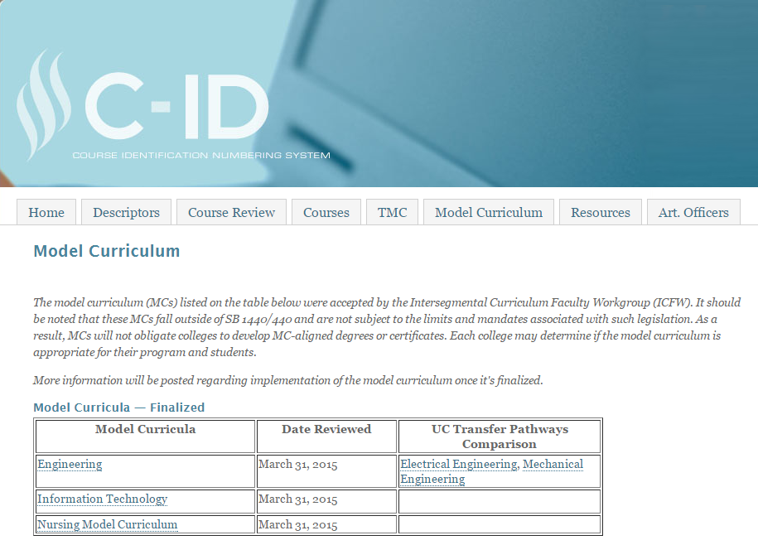
California Community College IT Model Curriculum
Notes:
C-ID process and Transfer Model Curriculum

Slide 10
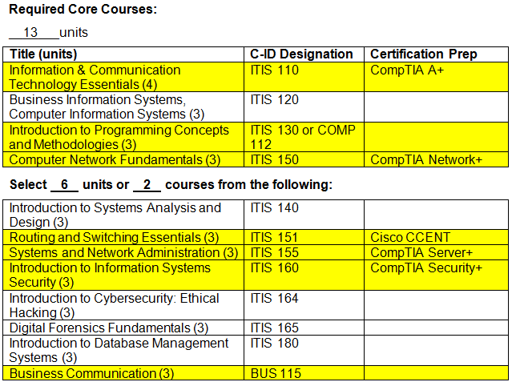
Information Technology - Model Curriculum
Notes:
Resulting ICT Model Curriculum Developed

Slide 11
IT Essentials PRE-REQ
Course Overview
IT Essentials covers fundamental computer and career skills for entry-level IT jobs. Students apply skills and procedures to install, configure, and troubleshoot computers, mobile devices, and software.
Benefits
For students seeking career-oriented, entry-level hardware and software skills to prepare for technical support roles, this course aligns with the CompTIA A+ certification.
This course also serves as a foundation for CCNA-level courses.
Features
Target Audience: Secondary and 2-year college vocational students
Prerequisites: None
Languages: Arabic, Chinese-S, Chinese-T, Croatian, English, French, German, Hebrew, Hungarian, Italian, Japanese, Polish, Portuguese-Brazilian, Romanian, Russian, Spanish, Turkish, Ukrainian
Course Delivery: Instructor-led
Eligible for College Credit: ITIS 110 (4 units)
Recommended Next Course: CCNA R&S Introduction to Networks
Learning Components
14 chapters
99 hands-on labs and 29 interactive activities
Cisco Packet Tracer, virtual laptop, and virtual desktop learning tools
14 chapter exams, 1 checkpoint exam, 1 skills review exam, 1 practice final exam, 1 final exam, 1 skills-based assessment, and 2 practice exams for CompTIA A+ certification

Slide 12
CCNA R&S: Introduction to Networks CORE
Course Overview
The first course in the Cisco CCNA Routing and Switching curriculum teaches students about the architecture, structure, functions and components of the Internet and other computer networks.
Students achieve a basic understanding of how networks operate.
Benefits
By the end of the course, students will be able to build simple LANs, perform basic configurations for routers and switches, and implement IP
addressing schemes.
Features
Target Audience: Secondary vocational students, 2-year and 4-year college students in Networking or Engineering programs
Prerequisites: None
Languages: Arabic, Chinese-S, Chinese-T, Croatian, English, French, German, Hungarian, Japanese, Portuguese-BR, Polish, Romanian, Russian, Spanish, Turkish
Course Delivery: Instructor-led
Eligible for College Credit: ITIS 150 (3 units)
Recommended Next Course: CCNA R&S Routing & Switching Essentials
Learning Components
11 chapters
33 hands-on labs and 1 hands-on skills assessment
Pre-test, 11 chapter quizzes, 2 sectional quizzes, 11 chapter exams, and 1 final exam
2 Cisco Packet Tracer Skills Based Assessments

Slide 13
CCNA R&S: Routing and Switching Essentials CORE
Course Overview
The second course in the CCNA Routing and Switching curriculum describes the architecture, components, and operations of routers and switches in a small network.
Students learn how to configure a router and a switch for basic functionality.
Benefits
Students are ready to prepare for CCENT certification, skilled to apply for entry-level network technician jobs and able to move on to advanced certifications.
Features
Target Audience: Secondary vocational students, 2-year and 4-year college students in Networking or Engineering programs
Prerequisites: CCNA R&S: Introduction to Networks
Languages: Arabic, Chinese-Simplified and Traditional, English, French, German, Hungarian, Japanese, Portuguese-Brazilian, Polish, Russian, Spanish, Turkish
Course Delivery: Instructor-led
Eligible for College Credit: ITIS 151 (3 units)
Recommended Next Course: CCNA R&S Scaling Networks or CCNA Security
Learning Components
9 chapters
19 hands-on labs and 2 hands-on skills assessment
Pre-test, 9 chapter quizzes, 2 sectional quizzes, 9 chapter exams, and 1 final exam
2 Cisco Packet Tracer Skills Based Assessments

Slide 14
Information Technology - Model Curriculum
IT Essentials
Intro to Networks
Routing and Switching
Notes:
Resulting ICT Model Curriculum Developed

Slide 15
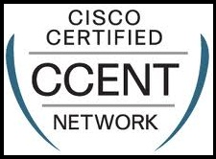
CCENT Certification Prep CORE
Course Overview
The Cisco Certified Entry Networking Technician (CCENT) is an entry-level Cisco certification. Credential holders possess the skills required to support small enterprise networks including installation, operation, and network security.
Benefits
Test prep for the Cisco Certified Entry-level Network Technician certification exam.
Features
Target Audience: 2-year and 4-year college students in Networking or Engineering programs
Prerequisites: : IT Essentials, Introduction to Networks, and Routing and Switching Essentials
Languages: English
Course Delivery: Instructor-led
Estimated Time to Complete: 40 hours
Learning Components
Review of certification exam objectives
Hands-on labs and hands-on skills assessment
Practice Exams

Slide 16
Business Communication CORE
Course Overview
This course applies the principles of ethical and effective communication to the creation of written and oral reports for a variety of business situations. The course emphasizes planning, organizing, composing, and revising business documents using word processing software for written documents and presentation-graphics software to create and deliver professional-level oral reports.
Benefits
Solve business communication problems through planning, problem solving, organizing, writing, listening and presenting techniques.
Demonstrate an understanding of social etiquette and a sensitivity to audience needs and desire, including cross-cultural situations.
Features
Target Audience: Secondary vocational students, 2-year and 4-year college students
Prerequisites: Eligible for College English
Course Delivery: Instructor-led
Eligible for College Credit: BUS 115 (3 units)
Estimated Time to Complete: 54 hours
Learning Components
Elements of the communication process.
Written Communication Practice
Oral Communication Practice
Scenario-based (IT) exercises

Slide 17
Systems & Network Administration-Linux & MS CORE
Course Overview
This course will provide a student with the knowledge and skills required to build, maintain, troubleshoot and support server hardware and software technologies. The student will be able to identify environmental issues; understand and comply with disaster recovery and physical / software security procedures; become familiar with industry terminology and concepts; understand server roles / specializations and interaction within the overall computing environment
Benefits
Learn to build, maintain, troubleshoot, and support server hardware/software technologies.
Features
Target Audience: Secondary vocational students, 2-year and 4-year college students
Prerequisites: IT Essentials, Introduction to Networks, and Routing and Switching Essentials.
Course Delivery: Instructor-led
Eligible for College Credit: ITIS 155 (3 units)
Estimated Time to Complete: 54 hours
Learning Components
Review of Microsoft and Linux operating systems
Hands-on labs using NETLAB+
Skills Based Assessments

Slide 18
Intro to Information System Security - Security+ CORE
Course Overview
An introduction to the fundamental principles and topics of Information Technology Security and Risk Management at the organizational level. It addresses hardware, software, processes, communications, applications, and policies and procedures with respect to organizational Cybersecurity and Risk Management
Benefits
Identify the fundamental concepts of computer security, security threats and vulnerabilities and examine network security.
Identify compliance and operational security measures.
Preparation for the CompTIA Security+ certification exams.
Features
Target Audience: Secondary vocational students, 2-year and 4-year college students
Prerequisites: IT Essentials, Introduction to Networks, and Routing and Switching Essentials.
Course Delivery: Instructor-led
Eligible for College Credit: ITIS 160 (3 units)
Estimated Time to Complete: 54 hours
Recommended Next Course: CCNA Security
Learning Components
Review the fundamental principles of information systems security
Hands-on labs using NETLAB+
Skills Based Assessments

Slide 19
CCNA Security CORE
Course Overview
CCNA Security introduces the core security concepts and skills needed to troubleshoot and monitor computer networks and help ensure the integrity of devices and data.
It emphasizes the practical application of the skills needed to design, implement, and manage network security systems.
Benefits
CCNA R&S students interested building security and data protection expertise for the Cisco CCNA Security career certification and jobs as network security specialists.
Features
Target Audience: 2-year and 4-year college students in Networking or Engineering programs
Prerequisites: : IT Essentials, Introduction to Networks, and Routing and Switching Essentials
Languages: English
Course Delivery: Instructor-led
Estimated Time to Complete: 70 hours
Recommended Next Course: CCNP R&S ROUTE
Learning Components
11 chapters, quizzes, and chapter exams
13 Cisco® Packet Tracer activities and one Packet Tracer Practice Skills Based Assessment (SBA)
16 hands-on labs
One each: pre-test, certification practice exam, practice final, final exam and skills-based assessment

Slide 20
Virtualization, DataCenter & Cloud CORE
Course Overview
Learn the essentials of virtualization, data center management, and supporting cloud computing.
Benefits
You will understand how virtualization, data center management, and cloud computing can reduce hardware and management costs associated with IT infrastructure. Preparation for VCP certification.
Learning Components
Learn the basics of virtualization technology at the computer, storage, network, desktop and application layers of IT infrastructure
Deploy and manage virtual machines
Manage user access to the VMware infrastructure
Describe the Virtualized Data Center (VDC) including techniques, resources, and storage virtualization.
Features
Target Audience: Secondary vocational students, 2-year and 4-year college students
Prerequisites: IT Essentials, Introduction to Networks, and Routing and Switching Essentials.
Course Delivery: Instructor-led
Estimated Time to Complete: 54 hours

Slide 21
Scripting - PowerShell/BASH CORE
Course Overview
Learn the essentials of PowerShell and BASH scripting languages. The IT industry and the rapidly growing IT Cloud need PowerShell and/or BASH scripting skills.
Benefits
PowerShell and BASH are programming software technologies designed to enable system administrators to manage the computers from the command line.
Features
Target Audience: Secondary vocational students, 2-year and 4-year college students
Prerequisites: IT Essentials, Introduction to Networks, and Routing and Switching Essentials.
Eligible for College Credit: ITIS 130 (3 units)
Course Delivery: Instructor-led
Estimated Time to Complete: 54 hours
Learning Components
Learn the basics of script-based programming languages
Hands-on labs using Powershell and BASH
Skills Based Assessments

Slide 22
Apprenticeship Program Training Schedule
Courses
PRE-REQS*
IT Essentials (A+)
Complimentary course work
CORE**
SUMMER 2017 (Jul 7 – Aug 11)
Orientation, Network Academy, and Prep for Fall
FALL SEMESTER 2017 (Aug 19 – Dec 15)
Business Communication (Bus 150)
CCNA 1- Intro To Networks (CISN 340) Class meets T/Th 5:00 – 6:50 PM
CCNA 2- Routing & Switching Essentials (CISN 341) T/Th 5:00 – 6:50 PM
WINTER SESSION 2018
CCENT Certification Prep
SPRING SEMESTER 2018 (Jan 13 – May 18, 2018)
Systems & Network Administration-Linux & MS
Intro To Information System Security- Security+
CCNA Security
SUMMER SESSION 2018 (June 5 – July 28, 2018)
Virtualization, Data Center and Cloud
Scripting - Bash/PowerShell/Other
FRIDAYS - Group Study, Lab Work, Tutoring and Mentoring
Students complete course work by July 28, 2018

Slide 23
